Slide 1
Luana’s Garden
UNIVERSITATEA TRANSILVANIA
FACULTATEA DE MATEMATICĂ ȘI INFORMATICĂ
Flower online shop
Nume: CHIȚU RALUCA-OANA
Program:Informatică ID – anul III
Grupa: 10LD511

Slide 2

CONTENT
TECHNOLOGIES
SITE ARHITECTURE
DATABASE
MOVIE

Slide 3
TECHNOLOGIES
HTML
BOOTSTRAP
Bootstrap (formerly Twitter Bootstrap) is a free and open-source CSS framework directed at responsive, mobile-first front-end web development. It contains HTML, CSS and (optionally) JavaScript-based design templates for typography, forms, buttons, navigation, and other interface components.
CSS
Cascading Style Sheets (CSS) is a style sheet language used for specifying the presentation and styling of a document written in a markup language such as HTML or XML (including XML dialects such as SVG, MathML or XHTML).CSS is a cornerstone technology of the World Wide Web, alongside HTML and JavaScript.
JAVASCRIPT
PHP
The Hypertexts Markup Language or HTML is the standard markup language for documents designed to be displayed in a web browser. It defines the content and structure of web content. It is often assisted by technologies such as Cascading Style Sheets (CSS) and scripting languages such as JavaScript.
JavaScript , often abbreviated as JS, is a programming language and core technology of the World Wide Web, alongside HTML and CSS. As of 2024, 98.9% of websites use JavaScript on the client side for webpage behavior, often incorporating third-party libraries. All major web browsers have a dedicated JavaScript engine to execute the code on users' devices.
PHP is a general-purpose scripting language geared towards web development. It was originally created by Danish-Canadian programmer Rasmus Lerdorf in 1993 and released in 1995. The PHP reference implementation is now produced by the PHP Group.PHP was originally an abbreviation of Personal Home Page, but it now stands for the recursive initialism PHP: Hypertext Preprocessor.
CONTENT

Slide 4
ARHITECTURE
ARHITECTURE
PRODUCTS
LOCATIONS
MAIN
LOGIN
REGISTER
ABOUT
CONTENT

Slide 5
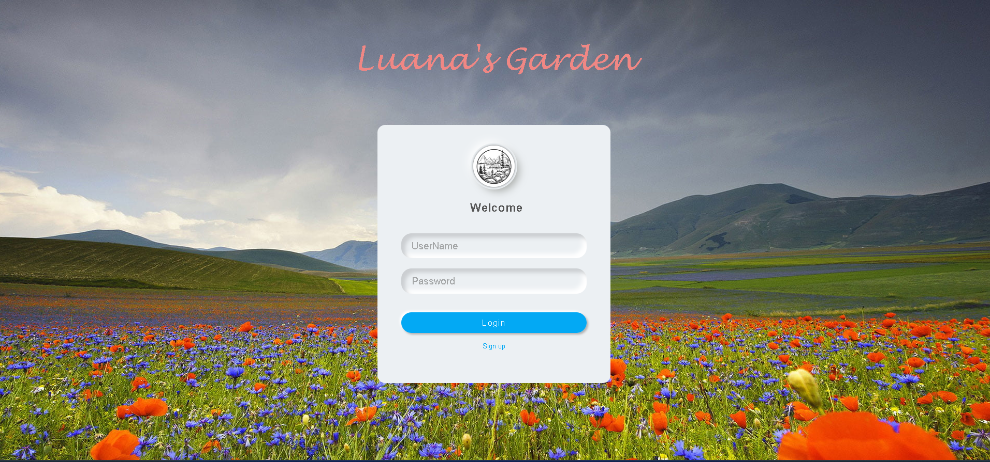
LOGIN
ARHITECTURE

Slide 6
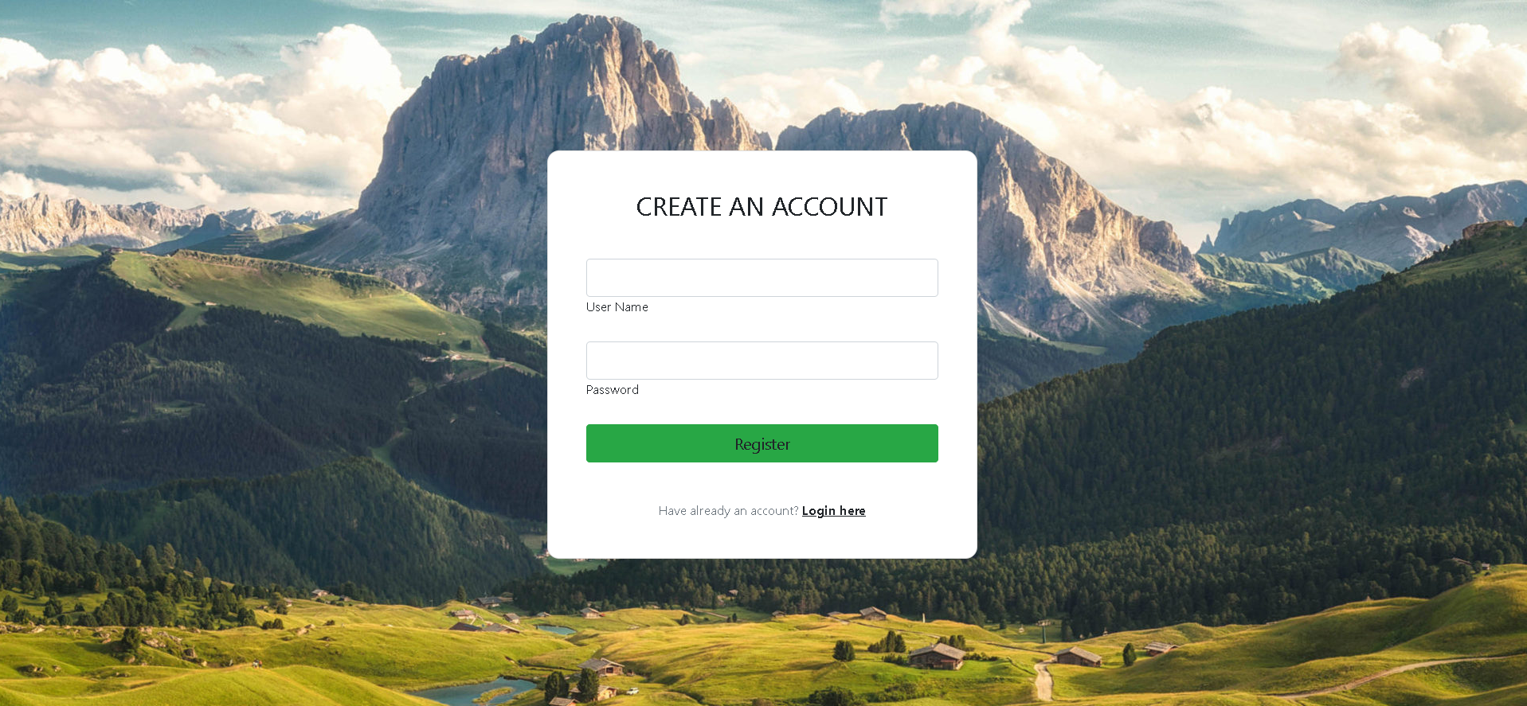
REGISTER
ARHITECTURE

Slide 7
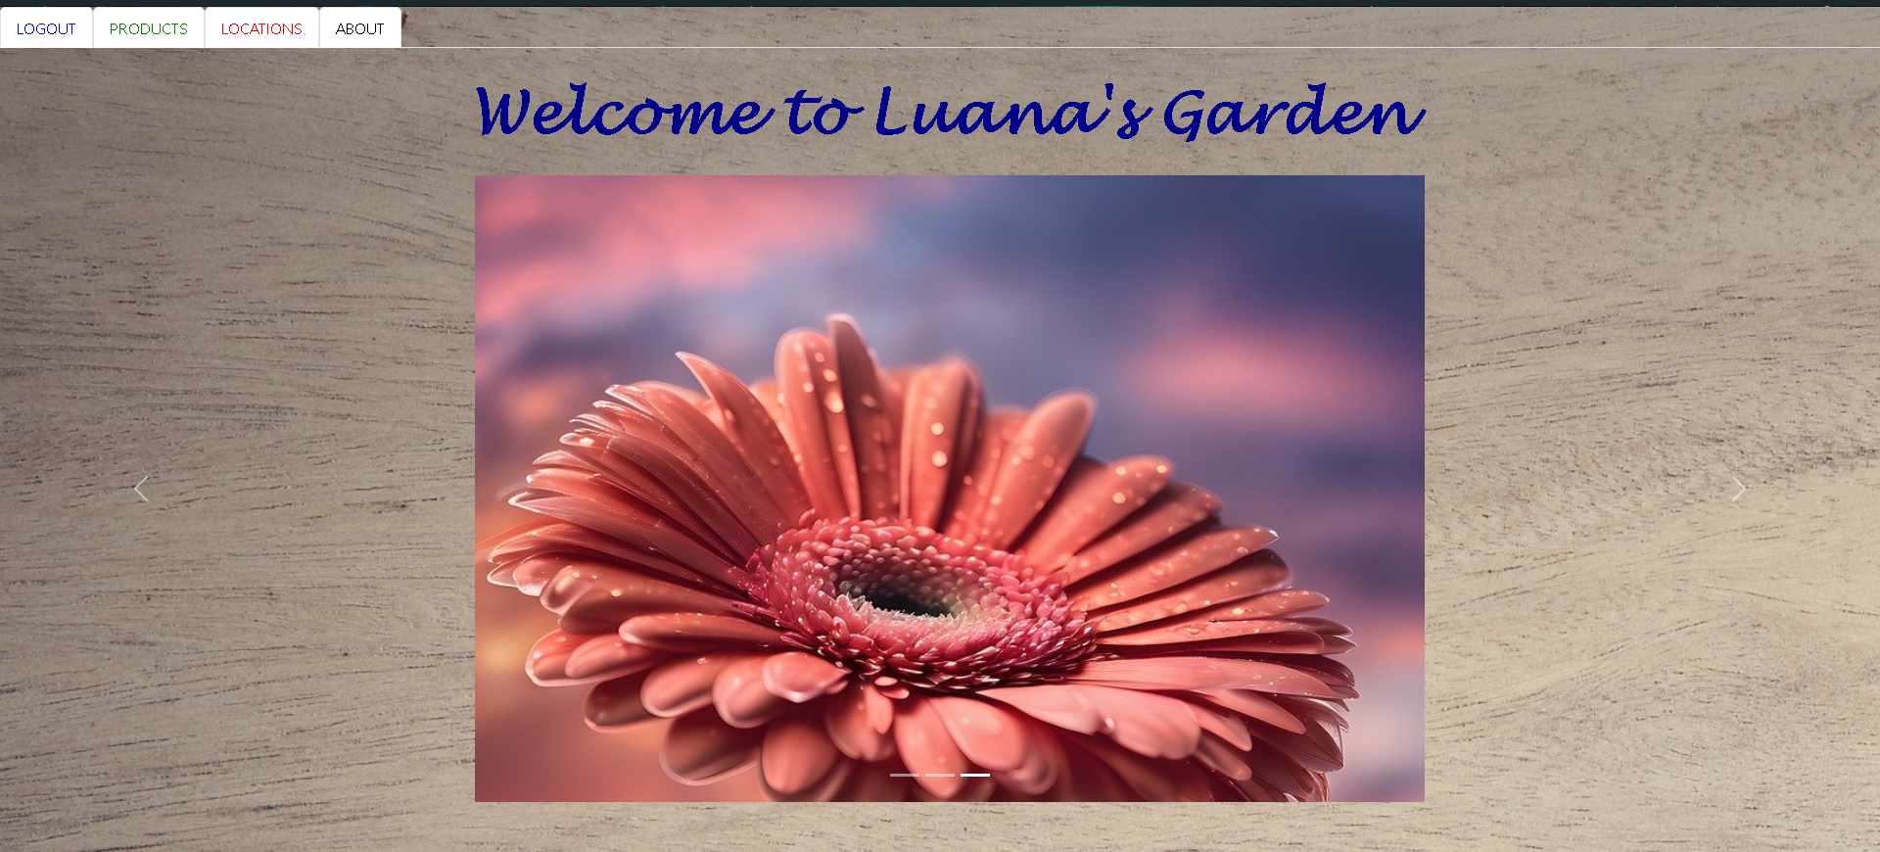
MAIN
ARHITECTURE

Slide 8
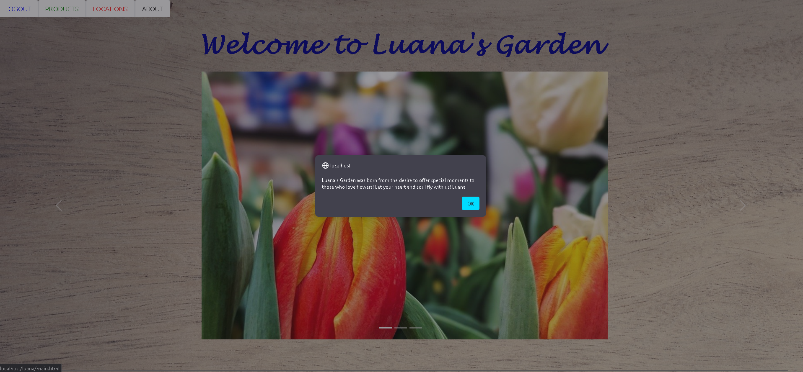
ABOUT
ARHITECTURE

Slide 9
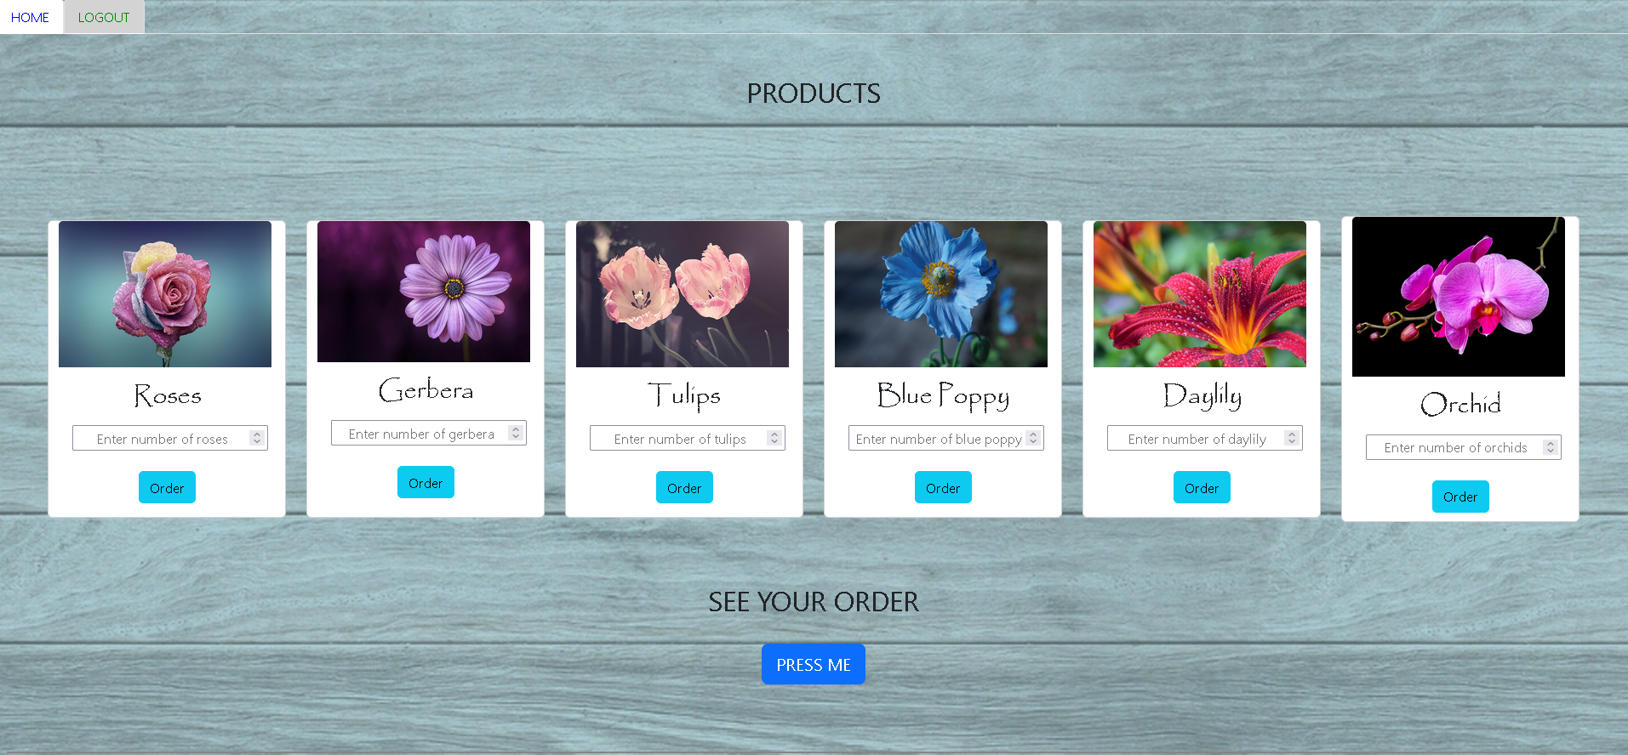
PRODUCTS
ARHITECTURE

Slide 10
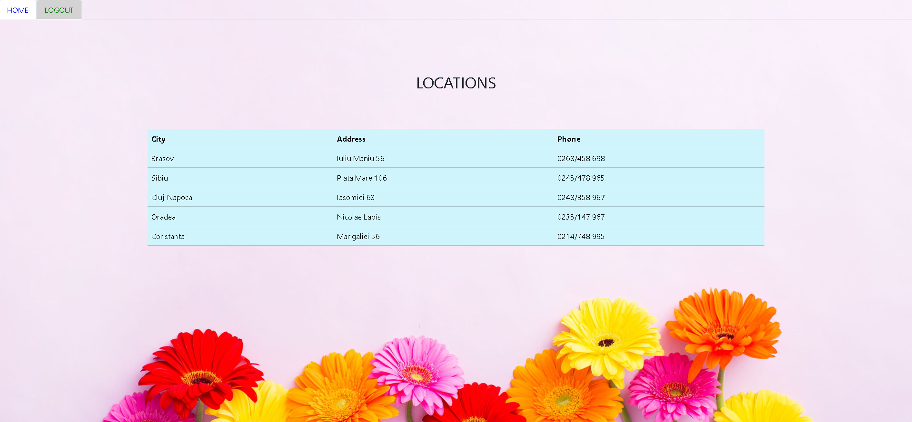
LOCATIONS
ARHITECTURE

Slide 11
DATABASE
LUANA’S GARDEN
users
products
locations
CONTENT

Slide 12
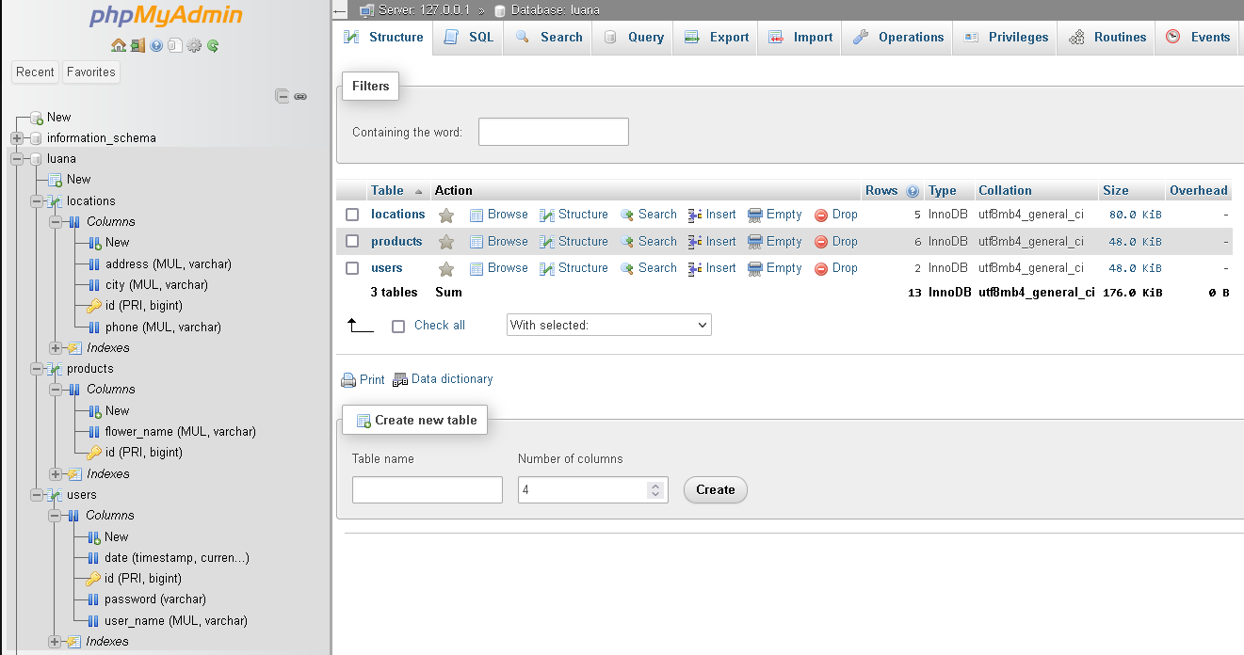
DATABASE - visual
DATABASE

Slide 13
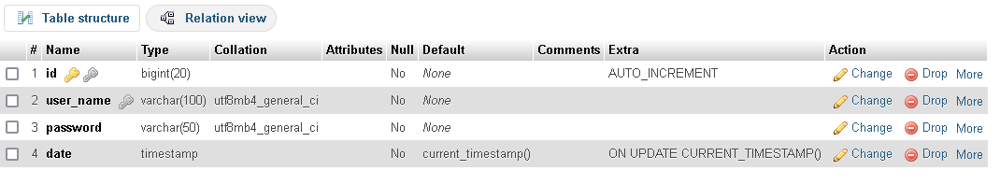
users - definition
Columns:
id - is the primary key of the table and it is automatically incremented when a new entry is added
user_name: contains the name for each user
password: contains the password for each user
date: used to automatically register the date of a user creation.
DATABASE

Slide 14
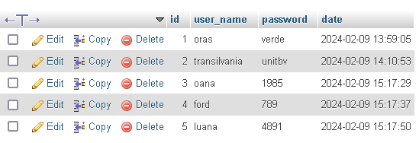
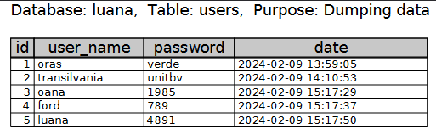
users - content
From phpMyAdmin
Exported in PDF
DATABASE

Slide 15
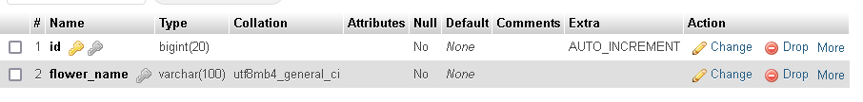
products - definition
Columns:
id - is the primary key of the table and it is automatically incremented when a new entry is added
flower_name: contains the name for each flower type (e.g. roses, tulips)
DATABASE

Slide 16
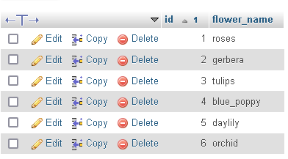
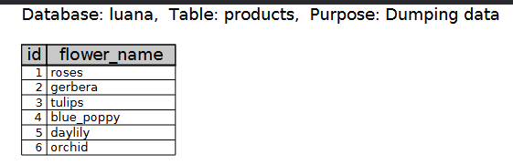
products - content
From phpMyAdmin
Exported in PDF
DATABASE

Slide 17
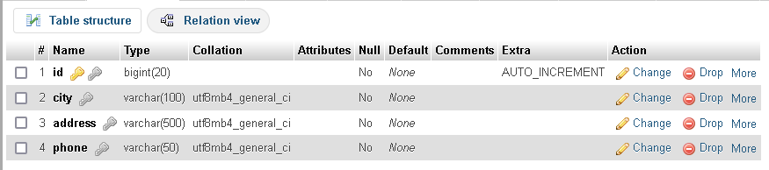
locations - definition
Columns:
id - is the primary key of the table and it is automatically incremented when a new entry is added
city: contains the city for each location
address: contains the address for each location
phone: is the phone number for each location
DATABASE

Slide 18
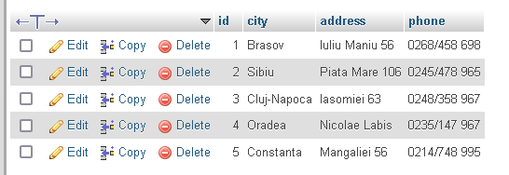
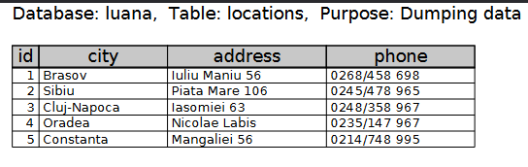
locations - content
From phpMyAdmin
Exported in PDF
DATABASE

Slide 19
Thank you!
CONTENT

